Slide 1
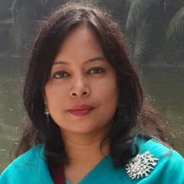
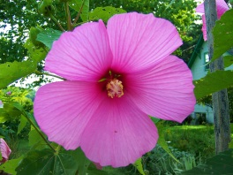
W
E
L
C
O
M
E
INTRODUCTION
CLASS: SIX
SUBJECT: ENGLISH SECOND PAPER
UNIT: ONE
LESSON: ONE
TOPIC: PARTS OF SPEECH (NOUN)
ROUFUN NAHAR
ASSISTANT TEACHER ( ENGLISH)
MAZIDA GOVT. HIGH SCHOOL
TONGI, GAZIPUR

Slide 2
This slide is hidden.
Notes are given for the honourable teachers bellow the slides no. 3, 4, 6-11, 13 and 15 .

Slide 3
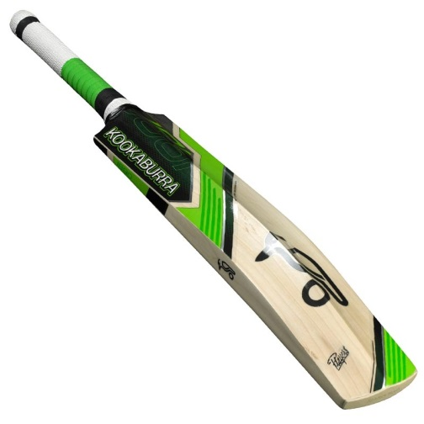
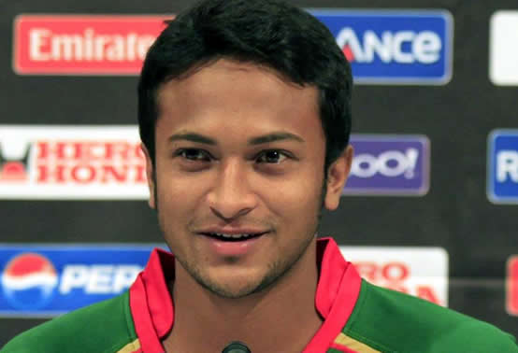
Sakib Al Hasan
What is the name of this thing?
Bat
What is his name?
Can you make sentence with this naming word?
Can you make sentence with this naming word?
Notes:
The students can make sentence orally or they can write sentences on the board. Answers can vary here.

Slide 4
1. Sakib Al Hasan is a cricket player.
2. He plays with the bat.
Nouns.
The naming words in a sentence are called
Notes:
Showing this slide The teacher can clarify what noun is.

Slide 5
LEARNING OUTCOMES OF THE LESSON
By the end of the lesson the students will be able to
say what noun is.
identify noun.
mention some nouns from real life situation.
make sentence with noun as a subject.
make sentence with noun as an object.

Slide 6
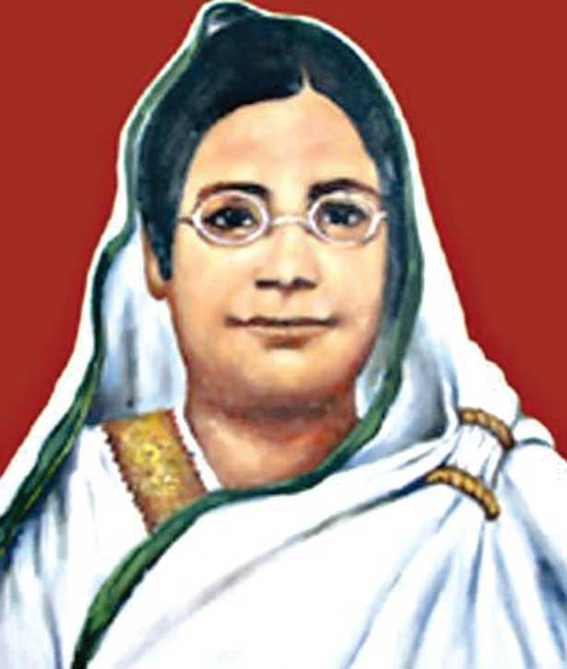
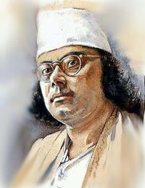
Can you tell the names of the persons?
Can you make sentences with these naming words?
1
2
Begum Rokeya
Kazi Nazrul Islam
1. Begum Rokeya is a social worker and a writer.
2. Kazi Nazrul Islam is our national poet.
Notes:
The students can make sentence orally or they can write sentences on the board. Answers can vary here. Showing the sentences The teacher can say that when the names of persons are used in a sentence they are called noun.

Slide 7
Can you tell the name of this thing?
Rose
Leaf
Can you make sentence with this naming word?
Can you make sentence with this naming word?
Notes:
The students can make sentences orally or they/teacher can write sentences on the board. Answers can vary here. The sentences will not be erased. Those will be on the board.

Slide 8
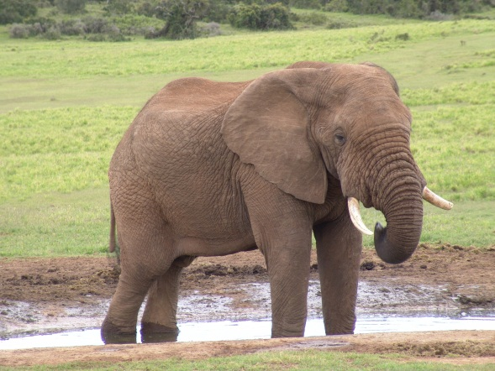
Can you tell the name of this animal?
Elephant
Can you make sentence with these naming word?
Notes:
The students can make sentences orally then they/teacher can write sentences on the board. Answers can vary here. The sentences will not be erased. Those will be on the board.

Slide 9
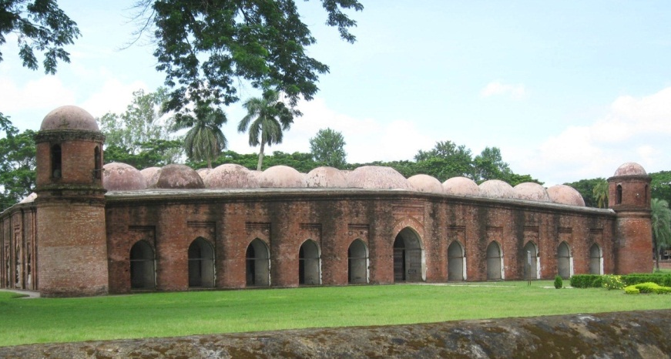
Can you tell the name of the building?
Sat Gombuj Mosque
Can you make sentence with this naming word?
Notes:
The students can make sentence orally then they/teacher can write sentences on the board. Answers can vary here. The sentences will not be erased. Those will be on the board.

Slide 10
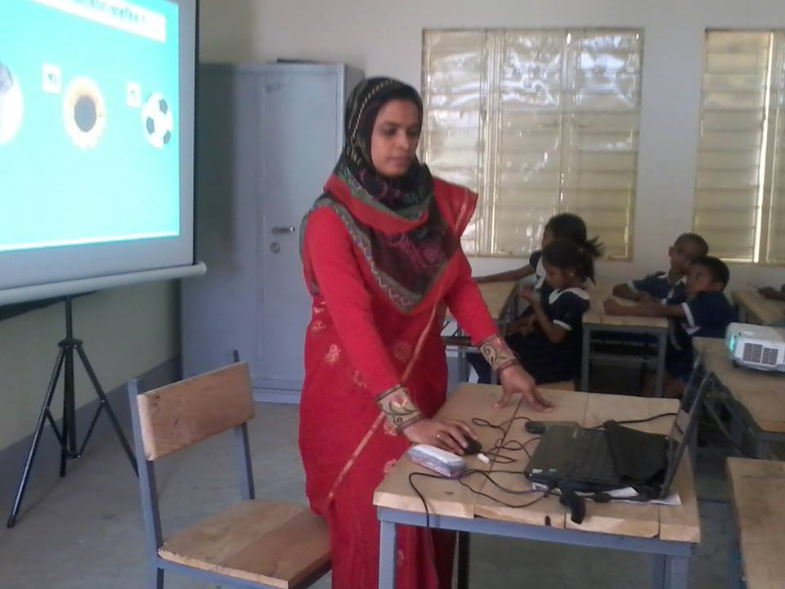
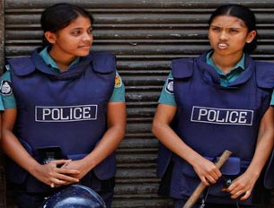
Can you tell the names of their professions?
1
2
Teacher
Police
Can you make sentences with these naming words?
Notes:
The students can make sentence orally then they/teacher can write sentences on the board. Answers can vary here. The sentences will not be erased. Those will be on the board.

Slide 11
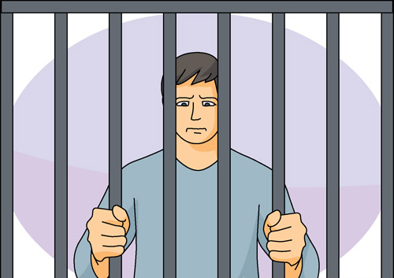
Can you make sentences with these naming words?
Can you match the names of the quality, action or state?
1
2
Happiness
Punishment
Punishment
Happiness
Knowledge
Notes:
The students can make sentence orally then they/teacher can write sentences on the board. Answers can vary here. The sentences will not be erased. Those will be on the board.

Slide 12
This slide is hidden.
Now the teacher can ask the students’ attention to the sentences written on the board. She/he can underline the naming words and tell the students that the underlined words are noun.

Slide 13
Look at the sentences and underlined words.
1. Kazi Nazrul Islam is our national poet.
2. The leaf is green.
3. The elephant is a big animal.
4. People like to visit Shat Gombuj Mosque.
5. The teacher is teaching.
6. Happiness keeps us healthy.
The name of any person, place, thing, idea, quality or state in a sentence is called noun.
Notes:
Showing this slide the teacher can explain again what noun is.

Slide 14
Pair work
Read the following passage and find out the nouns from it.
Anik Islam lives in Tongi. He is a student. His school is Mozida Govt. High School. He studies attentively. He is a singer too. He likes to sing folk song.
Answer
Anik Islam
Tongi
Student
school
Mozida Govt. High School
singer
song

Slide 15
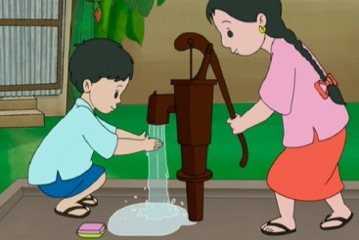
Pair work
Find out at least five naming words from the picture and make sentences with those nouns.
Notes:
Teacher may ask students to write the sentences in their writing copies. Answer may vary here. Teacher may give her/his own feedback.

Slide 16
Answer the following questions.
1. What is noun?
2. Find out at least five nouns from your classroom and make sentences with those nouns.

Slide 17
Home work
Look at your surroundings at home and write a list of ten nouns and make sentences with those nouns. (At least 20)

Slide 18
Acknowledgement
MoE, DSHE, NCTB & A2I respective of officials
And the editors panel: Ranjit Poddar, Associate Professor (English) TTC, Dhaka, Md. Jahangir Hasan (English), Assistant Professor TTC, Rangpur and Urmila Khaled Assistant Professor (English) TTC, Dhaka.
Their direction, valuable suggestions and intensive supervision have enriched the model contents.

Slide 19
THANK YOU ALL

